Slide 1
Sleep vs Caffeine
By Tyson Jeffrey

Slide 2
Question:
Does my caffeine consumption impact the amount of sleep I get?

Slide 3
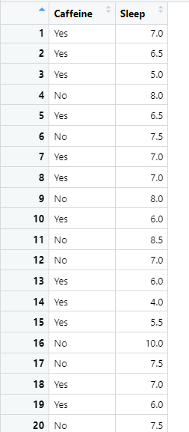
Data
20 Observations
Variables
Did I consume caffeine?
Yes or No
Sleep
Phone down to alarm clock
Confounding Variable
I tend to drink caffeine when I am putting in long nights of homework and studying which may tamper with results

Slide 4

Hypothesis Testing
Claim: The average amount of hours sleeping when there is no caffeine consumption is more than the average amount of hours sleeping when consuming caffeine.
Variables:
Dependent: Hours of sleep
Independent: Caffeine (Yes or No)

Slide 5
Hypothesis Testing
Form Hypotheses
Null
H₀: µ_{No}=µ_{Yes}
Alternative
H₁: µ_{No}>µ_{Yes}

Slide 6
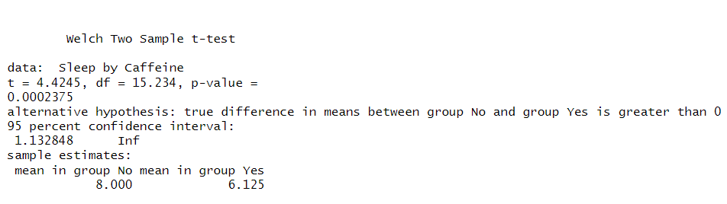
T-Test
T-Score
4.4245
P-Value
.0002375

Slide 7
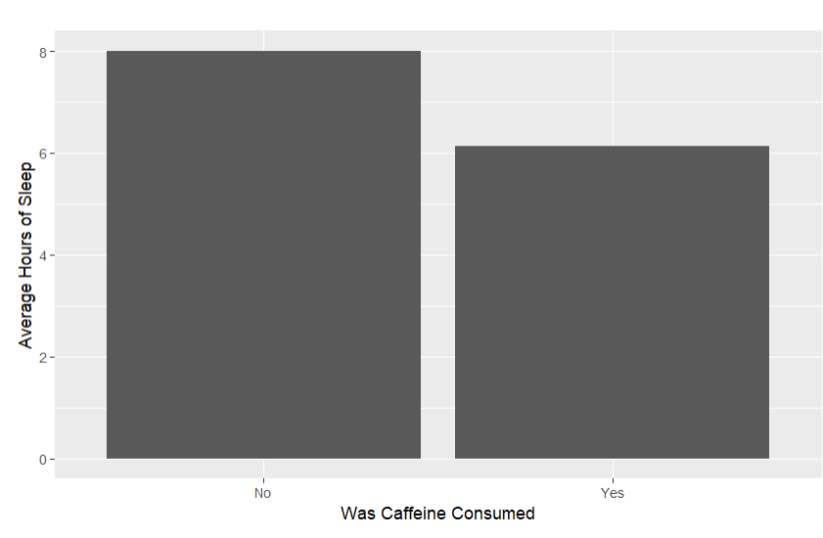
Conclusion
Because our P-Value is lower than our significance level of .05, we can reject the null hypothesis.
There is sufficient evidence to prove that there is more sleep on average when there is no caffeine consumption.

